Slide 1
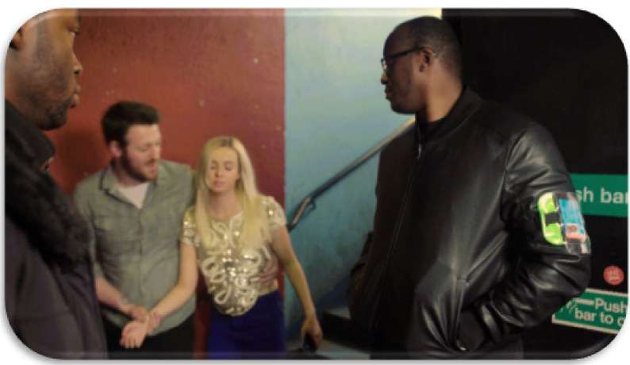
Vulnerability Awareness in Licensed Premises
Notes:
Trainer to introduce themselves
Cover House Keeping:
Length and structure of session
Refreshments
location of toilets
Emergency procedures to be followed
Fire exists / any fire drills planned etc.
Explain – there will be 2 short videos being played, with sound
Q: Is everyone ok to start?
Explain - What does WAVE stand for - Welfare And Vulnerability Engagement

Slide 2
Aim
To provide those working in the licensed industry with an awareness of vulnerability and their responsibilities towards people visiting their premises
Notes:
This input is focused specifically on Licensed Industry workers
However - The WAVE initiative is multi-faceted, and aims to raise awareness hollistically.
Other inputs have been developed to focus on:
friends of vulnerable persons, mainly in university settings, and also
the police and other stakeholders who have a direct interest in licensed premises.
Everyone can have a positive impact on people who are vulnerable

Slide 3
Objectives
Explore what vulnerability is within the Licensed Economy and how to identify it
Identify interventions that assist in preventing and reducing harm to vulnerable people in licensed premises
Notes:
Trainer to outline the objectives
The session will:
Explore what vulnerability is within the Licensed Economy and how to identify it.
Identify interventions that assist in preventing and reducing harm to vulnerable people in licensed premises.
Trainer to ask - What experience do the attendees have in dealing with vulnerable people?
Points to consider to encourage discussion:
Door supervisors already play an important role in protecting vulnerable people.
Build on experience and share knowledge with all staff to help spot early signs of vulnerability.
Ability to recognise vulnerable people and make interventions that will reduce the risk of harm to that person.
The overall aim is to increase safety in the Licensed Economy.
This doesn’t negate the need for people to look after themselves and act responsibly, however, there will be occasions when people either don’t realise the risk they face.

Slide 4
Key Principles
The 5 key principles of WAVE
Prevent/reduce violent crime linked to the licensed economy
Prevent/reduce sexual offences
Reduce preventable injury linked to alcohol and drug use in the licensed economy
Reduce opportunities for criminal activity and anti-social behaviour in licensed premises
Promote partnerships and engagement with communities and key stakeholders in the licensed economy
Notes:
5 Principles
The 5 key principles of WAVE – ultimately a prevention and harm reduction initiative.
Important to create and strengthen Partnerships between authorities and industry stakeholders – helps to ensure initiative is a success.
WAVE initiative helps to identify people before they become potentially vulnerable, and:
victims of crime
victims of anti-social behaviour
come to harm in any other way
Involved in crime/antisocial behaviour/harm
WAVE initiative ensures vulnerable people are properly supported with positive interventions.

Slide 5
Vulnerability
Anyone exposed to the possibility of being attacked or harmed, either Physically or Emotionally
Notes:
There are a number of ways of defining vulnerability - for the purpose of this session we will use the following broad definition:
‘Anyone exposed to the possibility of being attacked or harmed, either Physically or Emotionally’
Definition from Oxford English Dictionary:
(Factors that contribute to vulnerability are explored on slide 7)
Some people may be more familiar with the term; ‘At Risk’, however in this session we will use the term vulnerability.

Slide 6
What can make a person vulnerable?
Age
Alone
Drugs and or Alcohol
State of mind
Presence of an Offender
Notes:
Trainer to ask attendees:
Name some factors that may cause a person to be potentially vulnerable:
Age:
Younger people tend to be more vulnerable to risk of harm. But age not overriding factor.
Alone:
Separated from friends, appears lost, isolated, easily targeted.
Drugs & Alcohol:
Reduced inhibitions - decreased ability to make decisions
Changes perceptions of their own abilities and limitations
Signs - overly gregarious/passive, aggressive, lack of spatial awareness, appears unwell
State of mind:
Emotional or mental state at the time. This can be influenced by a range of factors – friends will usually notice a difference in behaviours first.
Presence of an Offender:
Risk of potential harm increases substantially when above factors combined with the presence of a criminal offender.

Slide 7
How To Recognise Vulnerability
Drowsy
Upset
Being controlled by somebody
Injury
Quiet
Excitable
Missing clothing
Unsteady on their feet
Incoherent
Irrational
Glazed eyes
Dishevelled appearance
Lost
Alone
Being plied with alcohol /drugs
Notes:
Trainer to ask attendees:
How would they recognise that somebody was vulnerable?
Discuss with group
A number of factors that may make someone vulnerable - list is not exhaustive.
Early identification of these signs will assist in deciding how to respond - each situation is likely to be different.
An offer to help may be refused - how you might respond to this?
Consider:
Do you give up?
Can you deal with things another way - are there other options?
You may get an aggressive response.
Has a crime taken place?
Trust your instinct - if you have concerns then make an intervention.

Slide 8
Video 1
Assault example | https://vimeo.com/252898413
RTC example | https://vimeo.com/252904056

Slide 9
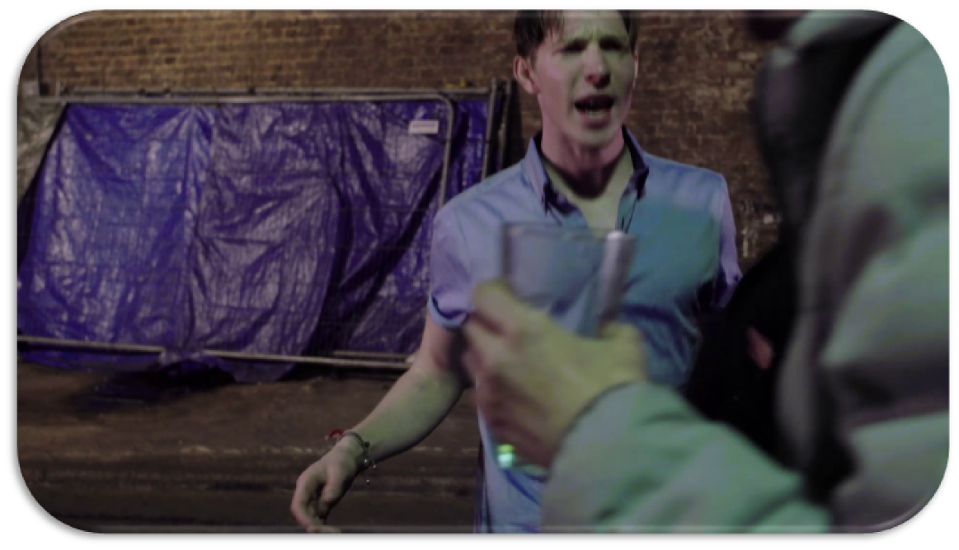
What happened?
Notes:
Note the scenarios depicted are not gender or crime specific
Trainer to ask the attendees:
“Consider the video from a personal perspective - how would you feel if this happened to a family member or friend?”
Trainer to lead discussion:
What’s just happened?
How do we feel about the video from a professional perspective? Discuss
Welfare & Safety Officer?
Staff interventions?
Refusals?
Is this an accurate reflection of events that may occur?
Preventable?

Slide 10
Where can we intervene to reduce vulnerability?
In street
In premises
Refusal of entry to premises
Ejection from premises
Notes:
Trainer to explain where interventions can take place including:
In street
In premises
Refusal of entry
Ejection of premises

Slide 11
Interventions ?
Age?
State of intoxication?
Do they have friends nearby?
Do they have their belongings?
Do they need medical attention/ambulance?
Does the premises have a Safe (WAVE) space where the person can be supported until assistance can be arranged?
Notes:
Trainer to discuss appropriate interventions:
It is important not to leave the vulnerable person on their own.
Age?
Is the individual vulnerable due to their age, young or old?
State of Intoxication?
Is the individual/group so intoxicated that it is not reasonable to expect them to be able take care of themselves?
What responsibility do you have to those refused entry?
Are they accompanied by others who may also be seeking entry - are they capable of taking responsibility of the individuals concerned?
Do they have friends nearby?
Where possible, attempts should be made to contact friends who may be able to assist. CCTV, ID scanners etc may well assist in identifying friends.
Is there an opportunity to make contact with family?
Do they have their belongings?
If persons are ejected without their belongings they may have no means to contact anyone, no money and/or appropriate clothing, which may render the person vulnerable.
Consider how you could assist the person in getting home safely?
Do you have access to a dedicated taxi service?
Do they need medical attention / ambulance?
Treat this as a priority and arrange immediately. Seek assistance from a colleague where possible, and obtain full details from emergency services, such as the call reference number.
Ensure staff are aware of the location of the medical kit and ensure it is in date and the staff are trained to use it.
Does the premises have an internal safe space? (WAVE Space)
A safe space could be a room or area where a vulnerable person can be taken and feel safe whilst arranging assistance.
Facilities should be made available so that the vulnerable person can make contact with friends or family, and receive medical assistance, or speak to an appropriate member of staff such as a welfare officer.
If your premises does not have a safe (WAVE) space, are there any local safe havens?
Does the premises have a Welfare Officer? (WAVE Officer)
It is important that the welfare officer is clearly identifiable to both customers and staff, and has appropriate training, which should include vulnerability awareness and interventions training, and additionally may include conflict resolution, first aid and crime response training. They may also be accredited by the Security Industry Authority (SIA) as a Door Supervisor (or Close Protection Officer).
Is there a Street Pastor available to assist?
A street pastor is a volunteer who can provide support and care to vulnerable persons

Slide 12
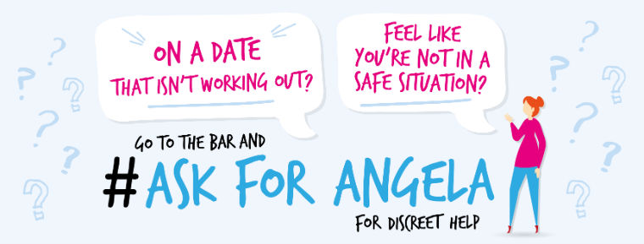
Ask for Angela
Notes:
Ask For Angela provides a useful additional tool for dealing with vulnerability.
Ask for Angela’ initiative aims to reduce sexual violence and vulnerability by providing customers with a non-descript phrase they can use to gain assistance from staff members in order to be separated from the company of someone with whom they feel unsafe due to that person’s actions, words or behaviour.
By “asking for Angela”, an individual should be treated as a vulnerable person and the interventions discussed in this training should be applied.

Slide 13
Presence of an Offender
Notes:
Trainer to ask - Who can commit a criminal offence?
Anyone from any background.
Offenders can be predatory or opportunistic in nature.
There is no one specific demographic relating to offenders.
Offenders may be looking to target vulnerable people to commit crime.
An offender may be looking to take advantage of a situation for their own benefit.
Trainer to ask – What behaviours may lead you to consider that an individual may go on to commit a criminal offence, and what can be done to mitigate a potential risk?

Slide 14
Video 2
Assault example | https://vimeo.com/252901800
RTC example | https://vimeo.com/252899877

Slide 15
Session Recap
Notes:
Trainer to recap the session objectives. The training was designed to:
Explore what vulnerability is within the Licensed Economy and how
to identify it.
Identify interventions that assist in preventing and reducing harm to vulnerable people in licensed premises.
We’ve looked at the definition and what can make someone vulnerable.
We’ve looked at visual signs that could indicate someone is vulnerable
We’ve looked at people who may seek to exploit that vulnerability.
Trainer to ask the group - What is the benefit of adopting WAVE in your premises?
Safer environments, reduced crime and harm, increased customer satisfaction, improved working partnerships, enhanced staff training, lower instances of ASB.

Slide 16
Questions
Notes:
Trainer to answer any questions.
Thank everyone for attending and contributing

Slide 17
Support Services
UK Police Service Provides links to all official police forces across the country and related organisations. Website: www.police.uk
The Rape and Sexual Abuse Support Centre Support and information for women and girls who have been raped or sexually abused, however long ago and whatever the circumstances. Helpline: 0845 1221 331 (Seven days a week) Website: www.rapecrisis.org.uk
NHS Direct Provides confidential nurse advice and health information. The service can also help you find a local genito-urinary medicine (GUM) clinic, where you can get checked for STIs. Helpline: 08457 4647 (24 hours a day, seven days a week) Website: www.nhsdirect.nhs.uk
Crimestoppers The organisation works for you, your family and your community to stop crime. You can call anonymously with information. Helpline: 0800 555 111 Website: www.crimestoppers-uk.org
Notes:
Support services.

Slide 18
If you have been affected by any of the issues raised in this presentation the following organisations may be able to assist
Notes:
End of presentation.

