Slide 2
Introduction
This slide deck provides a training template for your staff to make them aware of our Safe Space scheme, Operation Portum. Please feel free to amend to suit your training needs and style.
Thank you for your support of the scheme, your involvement will greatly increase the awareness and support available to anyone who feels vulnerable.
If any other assets are required, please contact us at the NBCC.
Patrick Holdaway
Superintendent
National Business Crime Centre
Click here to learn more

Slide 3
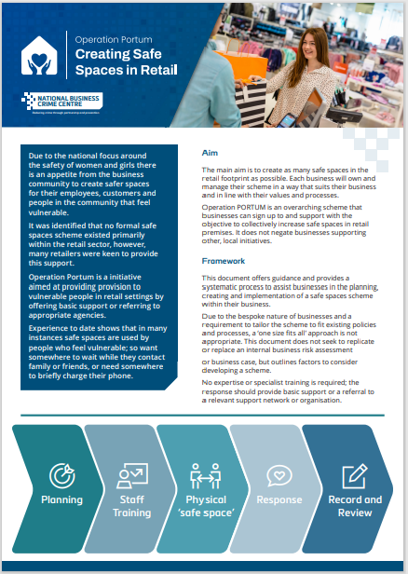
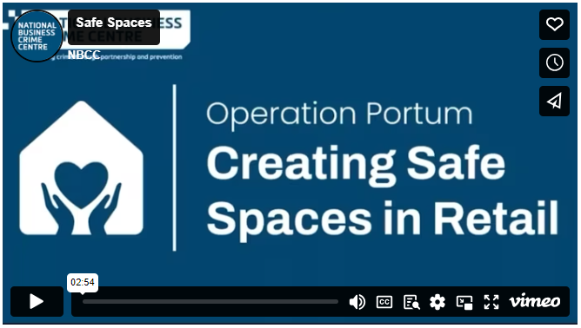
Training Assets
Watch training video
View guidance document
Notes:
These assets are also available to download from the NBCC website.

Slide 4

Objectives
What is Operation Portum?
Physical Safe Spaces
Training – what do our teams need?
Response – what should, and shouldn’t, we do?
Report and Review – what do we need?
Notes:
Talk through the following:
Start and finish times
Break times
Mobile phones / messages
Listen and respect others
Contribute and share
We are here today to talk about the Safe Spaces scheme and discuss how we can implement it in our organisation.

Slide 5

What is Operation Portum?
The business community has come together to create safer spaces for their employees, customers and people in the community who feel vulnerable for various reasons.
The Safe Spaces scheme, known as Operation Portum, is an overarching scheme that businesses can sign up to and support with the objective to collectively increase safe spaces in business premises such as retail, hospitality etc. Portum is Latin for haven, a place of safety or refuge.
Operation Portum is aimed at providing provision in business settings to people who feel vulnerable by offering basic support or referring to appropriate agencies.
Notes:
The retail community is coming together to create safer spaces for their employees, customers and people in the community who feel vulnerable for various reasons.
The Safe Spaces scheme also known as Operation Portum is an overarching scheme that businesses can sign up to and support with the objective to collectively increase safe spaces in retail premises.
Portum is Latin for haven, a place of safety, or refuge.
Operation Portum is aimed at providing provision in retail settings to vulnerable people by offering basic support or referring to appropriate agencies.
The National Business Crime Centre have created a video to explain the scheme, let’s watch it now.

Slide 6










































Supporters of Op Portum
Notes:
At the end of the video, you will see the businesses supporting the scheme, since it has gone live the number of businesses participating has increased significantly – and it just keeps growing.
Be proud to be part of this community providing support and assistance to those in need of it.
Are there any other companies that you support, or support you e.g. retailers, shopping centres, private security providers, if so inform them of your participation.

Slide 7


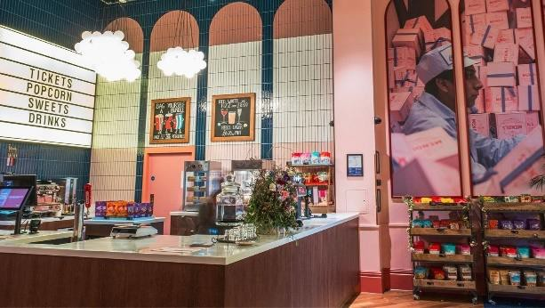

What is Operation Portum?
We know that when people feel vulnerable, they will look for places they know or there are brands they trust, they will feel safe. This will often be:
Recognisable shops
Restaurants
Cinemas
Safe Spaces are used by people who feel vulnerable. They want somewhere to wait while they contact family or friends or need somewhere to charge their phone.
We want to ensure that our people are prepared to deal with these situations and understand what they should and shouldn’t do to support them without putting anyone at risk.
The National Business Crime Centre have developed specific guidance, based upon best practice, of what should be done to support those who feel vulnerable. We are using that guidance in training our teams, and in preparing to run the scheme in our business.
Notes:
We know that when people feel vulnerable, they will look for places where they will feel safe. This will often be recognisable shops, restaurants or other businesses, like cinemas.
Experience to date shows that in many instances safe spaces are used by people who feel vulnerable, so want somewhere to wait while they contact family or friends or need somewhere to briefly charge their phone.
When this happens, we want to ensure that our people are prepared to deal with the situation and understand what they should and shouldn’t do.
The National Business Crime Centre have developed specific guidance, based upon best practice, of what should be done to support those who feel vulnerable.
We are using that guidance for training our teams, also for planning out how to operate the scheme in our locations.

Slide 8
Planning
Before launching the scheme in your [insert location], you need to plan a few things:
Set expectations with your team
Have discussions about what we consider a Safe Space
Determine where Safe Spaces will be in your [insert location]
How will we ensure our staff are aware of the Safe Spaces scheme and are kept updated?
Get in touch with the local police, community safety partnerships and shopping centre management (if applicable) to explain that you are taking part in the scheme
[Insert security company if applicable) are already a recognised partner of Portum
If you have a security guard, you should
  Communicate your agreed Safe Space with them
  Ensure they are aligned with our expectations
Notes:
Before launching the scheme in your location, you need to plan a few things:
• Set expectations with your team
• Have discussions about what we consider a Safe Space
• Determine where Safe Spaces will be in your organisation
• How will we ensure our staff are aware of the safe spaces scheme and are kept updated?
• Get in touch with the local Police, community safety partnerships, and where applicable, shopping centre management

Slide 9


Physical Safe Spaces
As each business is different, there is no “one size fits all” approach for choosing Safe Spaces.
Each [insert location] is different, so the Safe Spaces will differ for each site too.
Have a discussion with your team about where your Safe Spaces can be.
Use the next slide to see what you need to consider when choosing your Safe Spaces.
Exercise
Notes:
As each business is different, there is no “one size fits all” approach for choosing Safe Spaces. And each location is different, so the Safe Spaces will differ for each site too.
Exercise:
Have a discussion with your Team about where your Safe Spaces can be.
Use the next slide to see what you need to consider when choosing your Safe Spaces.

Slide 10

Physical Safe Spaces
Consider these things in your discussion:
Is there adequate lighting?
Are there accessible exit routes?
Is it covered by CCTV?
Is there line of sight/communication with other staff members?
Can we adapt the Safe Space depending on their circumstances?
Is the safe space appropriate for the user and their vulnerability?
Try to stay in public areas, but away from crowds
Don’t use high-risk areas like the manager’s office or cash office
If you are planning to use areas like meeting rooms:
  Is there anything confidential there?
  Is there anything that could be used for harm?
Once you have decided on where your Safe Space will be, make sure to communicate it to your team, so everyone will know where to take anyone asking for it.
Notes:
Consider these things in your discussion:
• Is there adequate lighting?
• Are there accessible exit routes?
• Is it covered by CCTV?
• Is there line of sight/communication with other staff members?
• Can we adapt the safe space depending on the circumstances?
• Is the safe space appropriate for the user and their vulnerability?
• Try to stay in public areas, but away from crowds.
• Don’t use high risk areas like the managers offices or cash office.
• If you are planning to use areas like meeting rooms: is there anything confidential there, or anything that could be used for harm?
Once you have decided on where your Safe Space will be, make sure to communicate it to your team, so everyone will know where to take anyone asking for it.

Slide 11

Training
No expertise or specialist training is required; the response should provide basic support or a referral to a relevant support network or organisation e.g. police, medical support.
How can we ensure that our employees feel safe, comfortable and appropriately trained/resourced to respond?
Should our employees be approached to support an individual who feels vulnerable we want to ensure that they are equipped to do so without putting them, the vulnerable person or our business at risk.
The Operation Portum scheme offers some very simple principles which, if followed, will give our teams the confidence to offer the right support to the person seeking help.
Our employees should be mindful to not be alone with the person seeking a Safe Space and should always be with a companion if possible.
Notes:
No expertise or specialist training is required; the response should provide basic support or a referral to a relevant support network or organisation.
How can we ensure that our employees feel safe, comfortable, and appropriately trained/resourced to respond?
Should our employees be approached to support an individual who feels vulnerable we want to ensure that they are equipped to do so without putting them, the vulnerable person or our business at risk.
The Operation Portum scheme offers some very simple principles, which if followed, will give our teams the confidence to offer the right support to the person seeking help.
Our employees should be mindful to not be alone with the person seeking a safe space and should always be with a companion where possible.
Our teams are at the heart of the safe spaces scheme. We need to provide them with what they need to stay safe and deal with a safe spaces’ scenario confidently and professionally.
Note:
Where will the training and guidance be stored in your organisation, and who can access it?

Slide 12
Response
Useful contacts:
Emergency Services
Authorities
Charities
Support Organisations
[If applicable list where these details are held]
Consider the diversity of the user and the employee dealing with them. You may need to adapt your response accordingly, e.g. responses to a young person may be different to an elderly person and may require different processes to protect your employees.
Be prepared for the possibility that some may attempt to misuse the scheme.
What should the team be aware of?
What steps should be taken if this occurs?
Notes:
Consider contact details of emergency services, authorities, charities and support organisations – do you have the information readily available, e.g. displayed in the manager’s office?
Consider the diversity: (cultural, racial, religious, age, sex/gender, sexual orientation, disability) of the user and the employee dealing with them. You may need to adapt your response accordingly, e.g. responses to a young person may be different to an elderly person and may require different processes to protect your employees.
Be prepared for the possibilities somebody may attempt to misuse the scheme
• How can we do this?
• What steps should be taken if this occurs?
Treat these incidents the same as you would anyone trying to gain access fraudulently. Repeated offenders should be reported to the police and recorded appropriately.

Slide 13
Response
In groups, discuss the following:
Exercise
What should a staff member do in a Safe Space scenario?
What should a staff member NOT do?
Notes:
Exercise:
In groups, discuss what staff members should and shouldn’t do in a Safe Space Scenario.
Split the team into at least 2 groups and ask them to produce a list of what employees should and shouldn’t do.
Allow a few minutes for discussion, then ask them to share ideas.
Once discussed, reveal the next slide for guidance.

Slide 14


Response
What should a staff member do in a Safe Space scenario?
What should a staff member NOT do?
Listen to the person
Assure them they can use the [insert location] as a Safe Space and we’ll do our best to assist them
Escort the person to a Safe Space and call a member of the leadership team
Stay with the person while waiting
Be judgemental or get personal
Offer their own phone to make calls
Take the person straight to the manager’s office or cash office, or somewhere isolated
Leave the person alone
Be with the person on your own, unless there’s no other option
Notes:
What should a staff member do in a safe Space scenario?
They should:
• Listen to the person
• Assure them they can use the location as a safe space, and we’ll do our best to assist them
• Escort the person to a Safe Space and call a member of the Leadership team
• Stay with the person while waiting.
What should a staff member NOT do?
They should not:
• Be judgemental, or get personal
• Offer their own phone to make calls
• Take the person straight to the manager or cash office, or somewhere isolated
• Leave the person alone
• Be with the person on your own, unless there's no other option

Slide 15
Response
In groups, now discuss the following:
Exercise
What should you, as members of the leadership team, do?
What should you NOT do?
Notes:
Exercise:
In the groups, now discuss what you think as members of the Leadership team do in a Safe Space scenario
Split the team again into at least 2 groups and ask them to produce a list of what they think they should and shouldn’t do.
Allow a few minutes for discussion, then ask them to share ideas.
Once discussed, reveal the next slide for guidance.

Slide 16
Response
What should you, as a member of the leadership team, do?
What shouldn’t you do?
Let the person explain why they feel vulnerable and what kind of support they need from you
Reassure them that you’ll do your best to assist them
Check if they have the means to make a call, if not, offer the site’s phone for them to use
Call emergency services if necessary
Make sure they feel safe and comfortable in the
Safe Space. If possible, don’t leave them alone until they have someone to accompany them
Do a quick risk assessment, and be prepared for the situation to change
Don’t be judgemental and ask personal questions or offer advice – stay impartial and only offer support
Don’t offer your own phone for calls
Don’t let them into the manager’s office or cash office, or other high-risk areas
Never put yourself or anyone else in danger – your safety is the priority
Be with the person on your own, unless there’s no other option
Notes:
What should you, as a member of the Leadership team do?
• Let the person explain why they feel vulnerable and what kind of support they need from you.
• Reassure them that you’ll do your best to assist them.
• Check if they have the means to make a call, if not, offer the site’s phone for them to use.
• Call emergency services if necessary.
• Make sure they feel safe and comfortable in the Safe Space. If possible, don’t leave them alone until they have someone to accompany them.
• Do a quick risk assessment and be prepared for the situation to change.
What shouldn’t you do?
• Don’t be judgemental and ask personal question or offer advice – stay impartial and only offer support.
• Don’t offer your own phone for calls.
• Don’t let them into the Manager Offices or Cash Office, or other high-risk areas.
• Never put yourself or anyone else in danger.
• Be with the person on your own, unless there's no other option
If your site has Body Worn Camera discuss the usage of the camera in these situations.

Slide 17

Record Keeping
Do we need to record details about the use of the scheme?
[Insert where you want these instances recorded]
Consider Data Protection and GDPR
The record should only include a description of the incident, and the person involved
The scenario may involve a personal matter or be of sensitive nature
Do not include any of these details in the report
Consider sharing information with appropriate agencies in the interest of safeguarding the user.
You will need to exercise your discretion and keep the users’ welfare at the forefront of any decisions.
nbcc.police.uk
Notes:
What is your guidance re the usage of the Body Worn Cameras?
• Do we need to record details about the use of the scheme?
• Consider Data Protection and GDPR – the record should only include description of the incident, and the person involved
• The scenario may involve a personal matter or be of sensitive nature – don’t include any of these details in the report
• Consider sharing information with appropriate agencies in the interest of safeguarding the user.
You will need to exercise your discretion and keep the user’s welfare at the forefront of any decisions.

Slide 18
Review
Consider periodic review of any incidents:
What is working well? Give praise and recognition where appropriate and share best practices.
What is not working so well? Be prepared to make changes if necessary. Can any lessons be learnt and shared to improve how we operate within the scheme?
Consider regular welfare checks on employees to ensure their continued wellbeing. People react and deal with things differently.
Are there any experiences or is there any learning that can be shared with the National Business Crime Centre so that the scheme can continually improve? Get in touch at contact@nbcc.police.uk
Notes:
Consider setting periodic review points of the scheme
• What is working well? Give praise and recognition where appropriate and share best practice.
• What is not working so well? Be prepared to make changes if necessary. Can any lessons be learnt and shared to improve the scheme?
Consider regular welfare checks on employees to ensure their continued wellbeing. People react and deal with things differently.
Consider referring the employee to your employee support service if necessary.

Slide 19
Next Steps
Compile a list of useful contacts to provide to the person or use to support
Review and agree on possible Safe Spaces in your [insert business/location]
Ensure leadership team complete the Operation Portum workshop
Ensure remaining team complete the Operation Portum training
Emergency services: 999 as well as local contact number
NHS24 on 111
If applicable:
Authorities: local council (usually office hours guidance)
Communicate to your security guard where your Safe Space is
Communicate to your security guard our expectations in relation to Operation Portum
Communicate with any local shopping centre, local police contact or equivalent
Charities e.g. Mind, Samaritans etc.
Other local support organisations
Notes:
Go through the ‘Next Steps’ slide and make sure all the points are actioned.

Slide 20
Any Questions?

